Slide 1
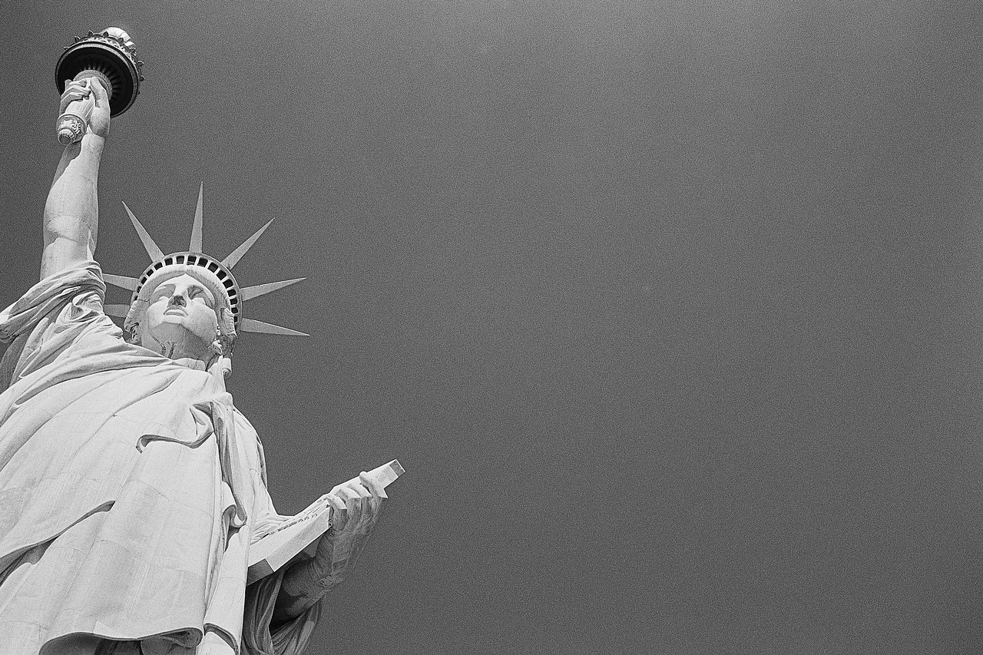
Immigration
Starting a New Life in America

Slide 2
For hundreds of years, people have moved to America from other countries. Millions of immigrants have come to the United States. They have come from every part of the world. Native Americans are the only Americans who lived in the United States long before other immigrants came to America. Perhaps you, your parents, or your grandparents were immigrants. Why did immigrants come to America?
Intro:

Slide 3
At first most immigrants came to America from Great Britain and other countries in Europe. Many people came to America for freedom of religion. Others came because they did not like the laws of their country. Many people were poor in western Europe. They thought they could earn more money in America.
Early Immigrants:

Slide 4
In the 1840s many people in Ireland were starving Irish farmers could not grow enough food. So thousands of Irish people came to the United States. They were hungry and poor. In America they helped build railroads. They worked in factories. John F. Kennedy was an Irish American who became the President of the United States in 1961. His great-grandfather had been an Irish immigrant.
Irish Immigrants:

Slide 5
Thousands of immigrants from China came to America after the Civil War. The Chinese helped build railroads in the West. Many of the Chinese immigrants settled in the West. Some Chinese Americans became farmers and store owners. Others made their living by fishing.
Chinese Immigrants:

Slide 6
African Americans were different from other groups of immigrants. They were forced to come to America as slaves. In 1619 the first African slaves were brought to the Virginia colony. Each year more Africans were forced to be slaves. Most slaves lived in the South. The slaves became free after the Civil War. Many of the free African Americans continued to work on plantations in the South. Many African Americans thought they could get better jobs in the North and in the West. From 1860 to 1920, thousands of African Americans moved to the North and to the West.
African Immigrants:

Slide 7
Before the 1880s many people from Germany and northern Europe came to America. Many had been farmers in Europe. They became farmers in the United States. From the 1880s to 1920s, other immigrant groups came to America. Millions of people left Italy, Russia, and Poland. They did not have enough food in Europe. They traveled to America on large, crowded ships. Most of these immigrants were very poor.
European/ Russian Immigrants:

Slide 8
Many of the immigrants from Russia and Poland were Jewish. They did not have freedom of religion in Poland and Russia. They had religious freedom and better jobs in the United States.
European/ Russian Immigrants:

