Slide 1
Industrailization
Develop Industry

Slide 2
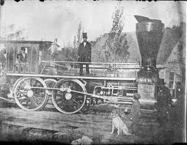
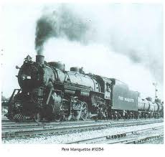
Big Business
After the Civil War, Life changed in America.
Americans lived and worked in cities in factories, railroads, stores, and other types of businesses.
One business owning many factories or smaller businesses is called big business. Also, one person could control a very large business. Railroads were an example of big business. The person could decide how much money to charge people to use the railroads.

Slide 3
Monopolies
The term monopoly means: when a single person owns and controls every part of an industry.
American monopolies:
Railroads- were made of steel
Steel Mills
Oil Refineries
Today: Microsoft is considered a monopoly

Slide 4
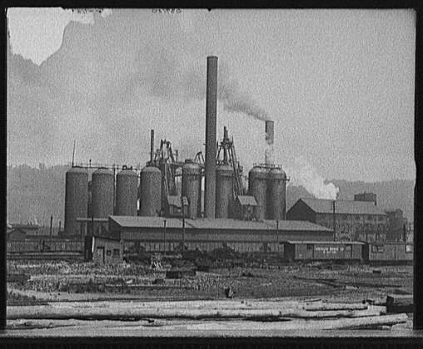
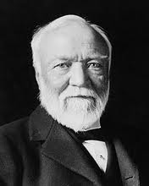
Andrew Carnegie
Andrew Carnegie was an immigrant from Scotland. He built factories in Pennsylvania for making steel. They were called steel mills. His steel mills were called the Carnegie Steel Company. He became rich and bought most of the steel mills in the United States. He was a millionaire and owned railroads and ships for sending steel. He was known as the “steel King.”

Slide 5
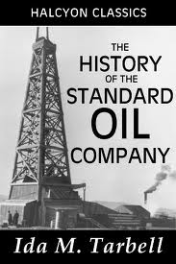
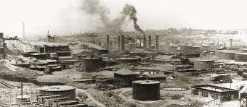
Oil Refineries
Oil was found deep in the Earth in Pennsylvania in 1859. People started drilling for oil in the United States. It had to be cleaned before using it, so it was cleaned in factories called oil refineries. In 1863, John D. Rockefeller built his first oil refinery. His business was called the Standard Oil Company.

Slide 6
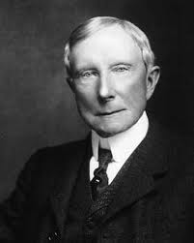
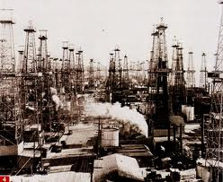
John D. Rockefeller
Sold his oil for less money than other oil companies. The other oil companies tried to sell their oil for less, but lost money. Rockefeller bought all the oil companies in America. He was also a millionaire.

Slide 7
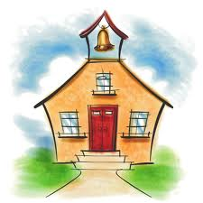
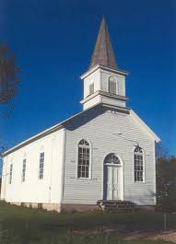
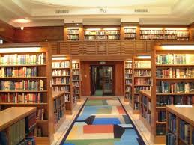
Rockefeller and Carnegie
John D. Rockefeller and Andrew Carnegie used their money to help other people. They gave money to schools and churches. Carnegie built many libraries.

Slide 8
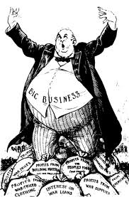
Big Business
Big businesses of railroads, steel, and oil helped America become a nation with tall buildings and many factories.
Many Americans thought it was not okay for a few companies to control all the oil, steel, and railroads in America. New laws were written in Congress which said that a few companies could not control all the big business in the U.S.
Why was it not okay for one company or person to control all the same industry?

