Slide 1
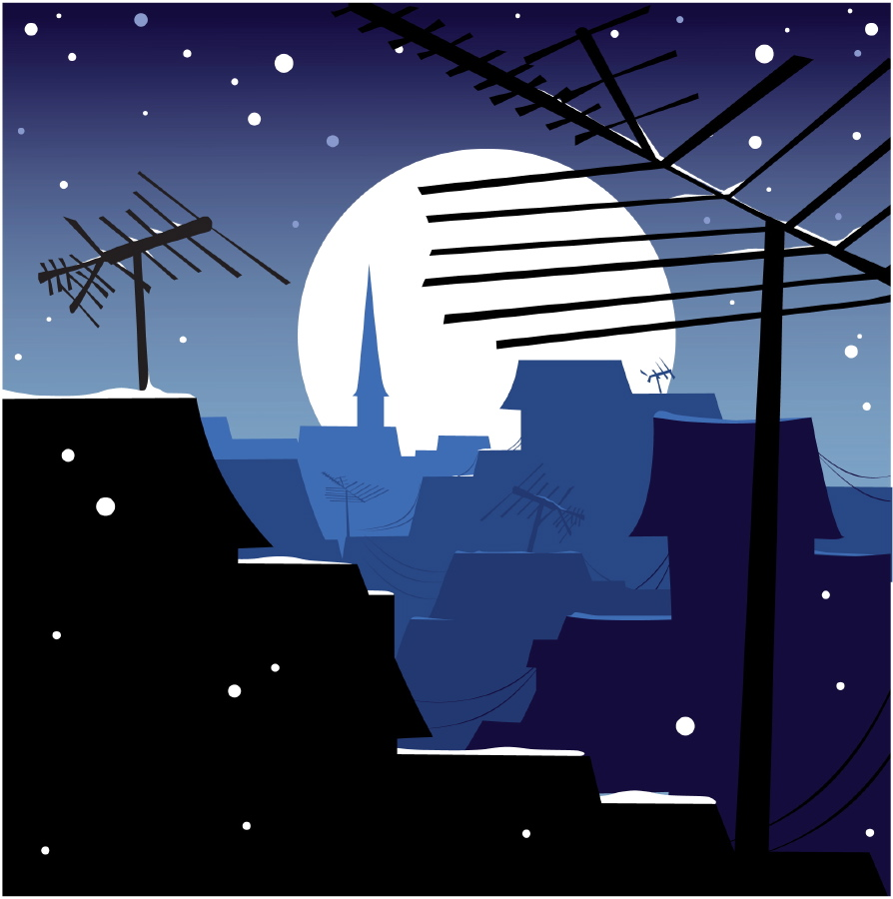
Life in America:
For an American Immigrant

Slide 2
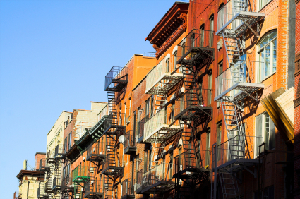
Most of the immigrants from Italy, Russia, and Poland lived in large cities in America. Many of them settled in New York City. The immigrants had many problem in America. They had to learn to read, write, and speak English. They lived in small, crowded houses. Many immigrants worked in dirty factories. Often they were paid very little for their hard work. Many of the children had to work all day in factories.

Slide 3
Immigrant children went to free schools in America. Their parents studied English in schools at night. Schools helped provide the immigrants become Americans. After they lived in the United States for five years, they could become American citizens. Then they were allowed to vote like other American citizens.

Slide 4
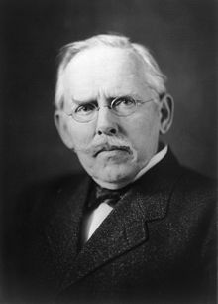
Jacob Riis was an immigrant from Denmark. He became a newspaper reporter in New York City. Jacob Riis loved being an American. He wanted to help the many poor immigrants in American cities. Riis wrote newspaper stories and a book about the new immigrants. He took photographs for his stories. His pictures showed the ugly, crowded houses where immigrants lived.

Slide 5
He took photographs for his stories. His pictures showed the ugly, crowded houses where immigrants lived. His stories said that there were no parks where immigrant children could play. People learned about immigrant life from Riis’ work. They wanted to help the immigrants. Better houses were built. Parks and playgrounds were built.

Slide 6
Jacob Riis Photo Gallery

Slide 7
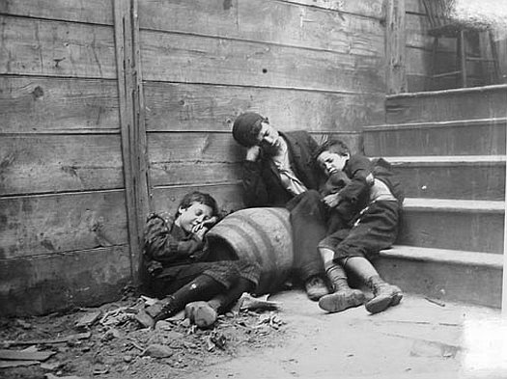

Slide 8
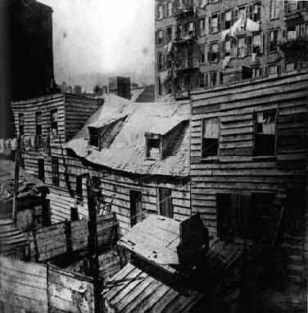

Slide 9
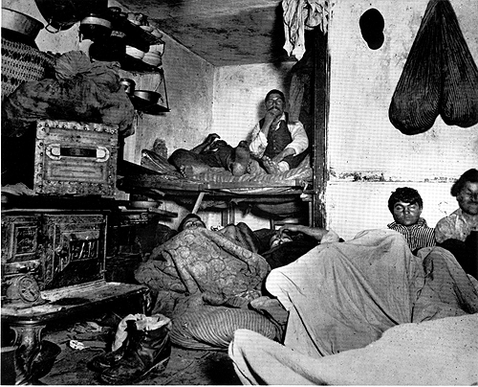

Slide 10
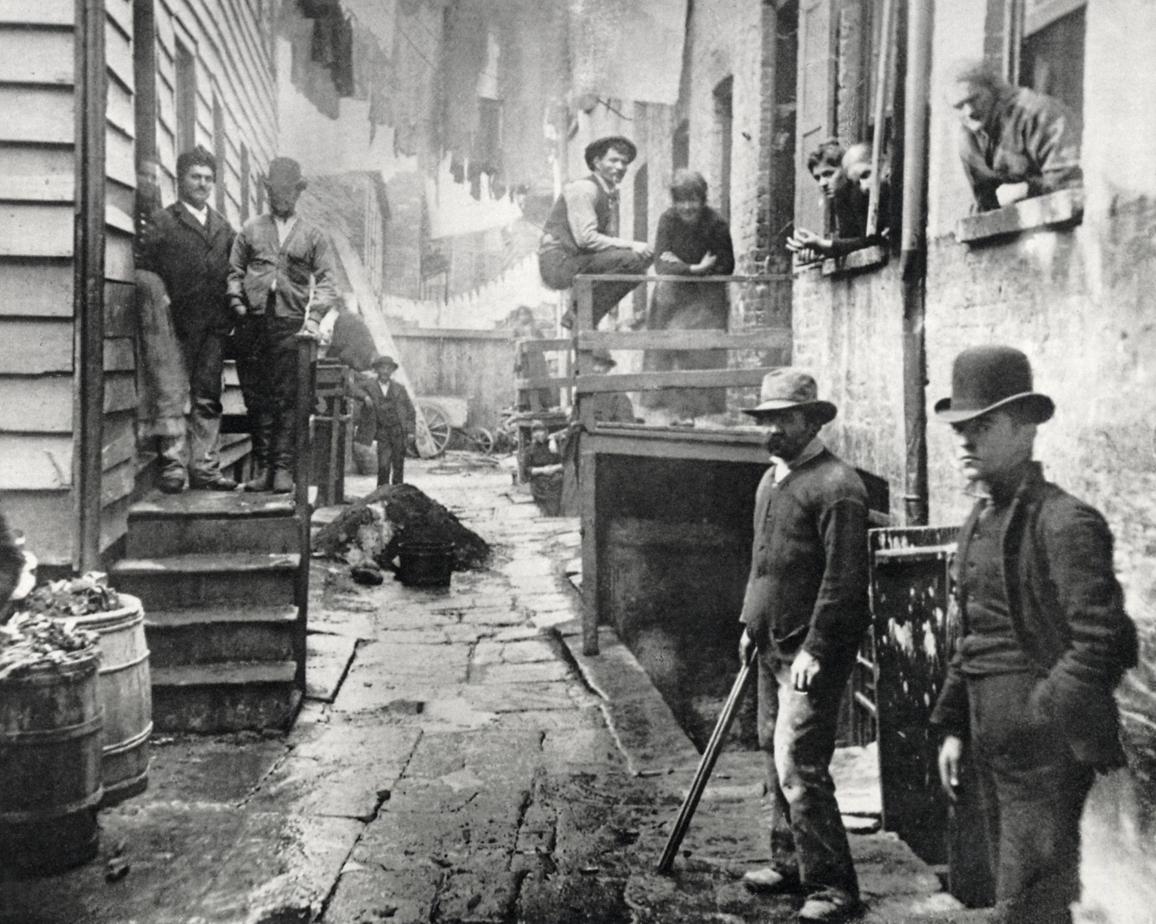

Slide 11
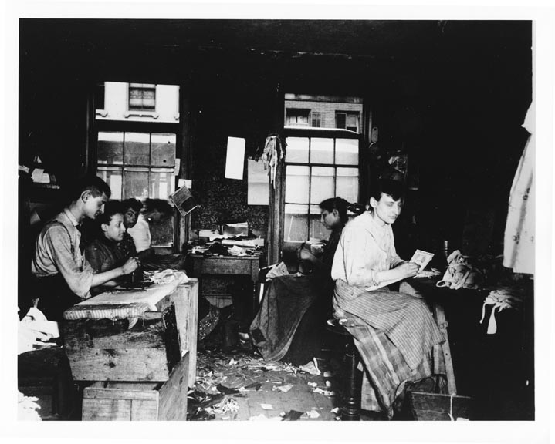

Slide 12
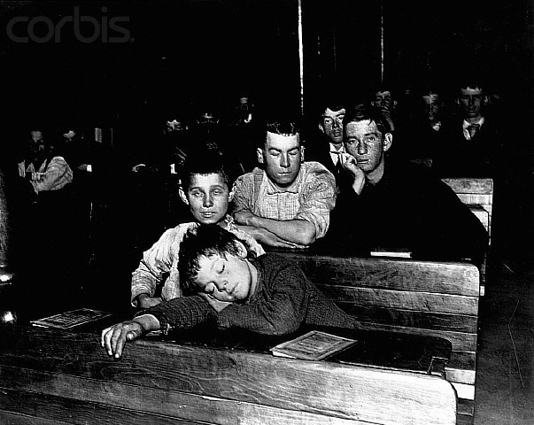

Slide 13
Millions of immigrants helped build America. They became store owners and farmers. They became store owners and farmers. Some became very rich. Some immigrants grew into government leaders. Others became teachers and doctors. Many immigrants built our factories and railroads.

Slide 14
Today our laws allow several hundred thousand immigrants to come to America every year. This year and every year, thousands of people from other countries will start a new life in America.

