Slide 1
New Inventions
Change the United States

Slide 2
Introduction
The United States grew from a country with 13 states to a country with 50 states. America changed in other ways too. At first most Americans lived on farms. The cities did not have many people. Today most Americans live and work in cities.

Slide 3
What’s an Invention?
Americans had very few machines to help them with their work 200 years ago. There were no telephones, cars, or electronic lights. People traveled on horses. People used candles to light their homes. Americans learned to make new machines. A new machine is called an invention. The new inventions made life easier and better for people in the United States and around the world.

Slide 4
Alexander Graham Bell
Alexander Graham Bell made, or invented, the first telephone. He was an immigrant from Scotland. Alexander was a teacher of children who were deaf. He taught them how to speak.
Alexander Graham Bell wanted to make a machine so that people who were far apart could talk to each other. Alexander worked on his machine for two years., In 1876 his machine worked. Alexander had made the world’s first telephone. In a few years, there were telephones in most American cities.

Slide 5
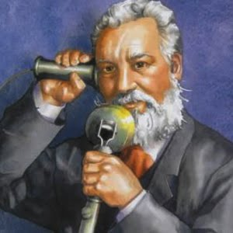
Alexander Graham Bell

Slide 6
Thomas Edison
A long time ago, American homes and streets were dark at night because there were no electric lights. Thomas Edison changed that. He invented the first electric light bulb. Thomas Edison started working on it in 1879. Finally, after many months, his bulb worked. It gave off light for a short time. Edison wanted his electric bulbs to burn for a long time. He continued to make different light bulbs. He learned how to make better bulbs that burned longer. The electric light bulb made our houses and streets bright at night.

Slide 7
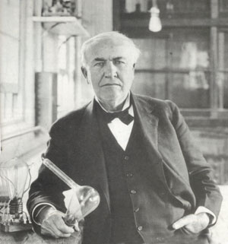
Thomas Edison

Slide 8
Henry Ford
For hundreds of years, people traveled on horses. Henry Ford changed the way Americans traveled. In 1896 Henry Ford made one of the first cars in America. He started a factory that made cars. His factory was called the Ford Motor Company. He did not want his cars to be expensive. Ford wanted many Americans to be able to buy his cars.
Henry Ford invented a new way to make cars in his factory. In the Ford factory, a conveyor belt carried the body of each car past the workers. Each worker put one part on the body of each car. Each worker stayed in one place and did the same job all day. In less than two hours, a car was put together. Cars were made very quickly with the conveyor belt, and were therefore less expensive.

Slide 9
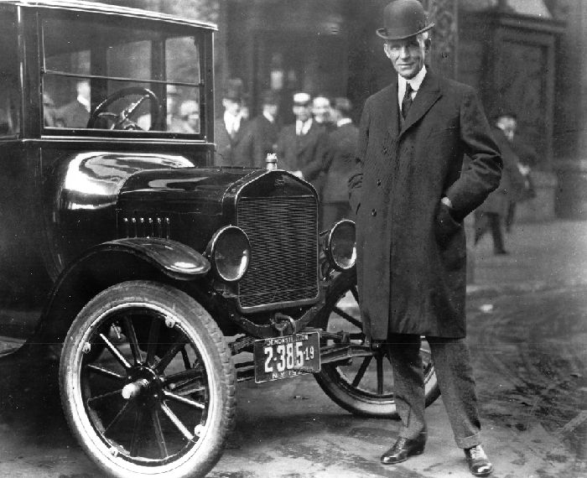
Henry Ford

Slide 10
Orville and Wilbur Wright
Orville and Wilbur Wright were brothers. They were called the Wright brothers. When they finished high school, the Wright brothers opened a bicycle store.
The Wright brothers wanted to make a machine that a person could fly. No one had ever made a motorized airplane that a person could fly. The two brothers worked on their machine for several years. They made a gasoline engine for their airplane. They made many kinds of wings. At last they thought their airplane had the right kind of wings. The Wright brothers were ready to fly.

Slide 11
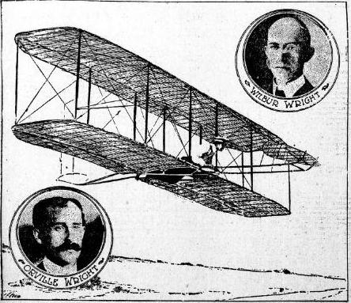
Orville and Wilbur Wright took their airplane to Kitty Hawk, North Carolina. They called their plane the Flyer. The brothers decided to fly their airplane on December 17, 1903. On that day the Flyer flew through the sky. The plane worked. The Wright brothers had made the world’s first motorized airplane.

Slide 12
Samuel Morse
Samuel Morse was the inventor of the single-wire telegraph system, a co-inventor of the Morse code, and an accomplished painter.
Samuel Morse invented the telegraph system after receiving a letter by horse messenger about his wife being ill after she had died and been buried. The new telegraph system, a system of wired communication, made sending written news much faster.
To communicate in this way, Morse co-invented the Morse code, a series of on and off tones. Today, ships on the sea and some radio stations still use this code as a method of communication.

Slide 13
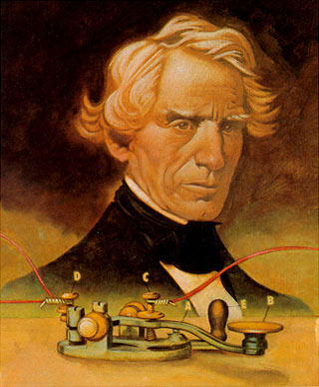
Samuel Morse

