Slide 1
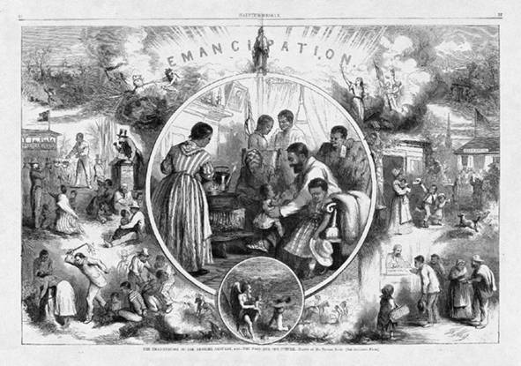
Reconstruction

Slide 2
Rebuilding the south
Americans in the North and South had hard work to do after the Civil War. Many cities and farms in the South were destroyed. The South had to be rebuilt. People in the North and South had to learn to like each other again. There was a lot of work to do.

Slide 3
Reconstruction
The years after the Civil War were called the time of Reconstruction. During this time the southern states rejoined the United States. The South was slowly rebuilt. Cities, farms, and roads were rebuilt. New railroads and schools were built. There were few factories in the South before the Civil War. After the war the South began to build factories. Southern farmers began to grow cotton again.

Slide 4
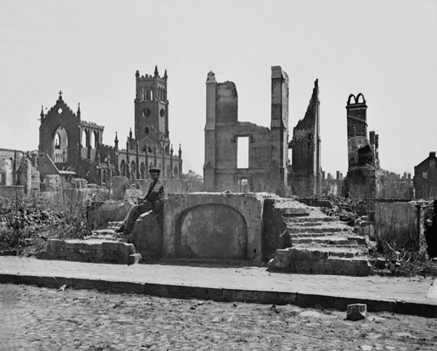

Slide 5
Freed Slaves
There were many African American slaves in the South before the Civil War. After the war the slaves became free people. After the slaves became free, they had many problems. Most African Americans had never gone to school. Many of them did not know how to read or write. They had little money. After the Civil War, African Americans needed jobs to earn money. But it was often hard for them to find jobs.

Slide 6
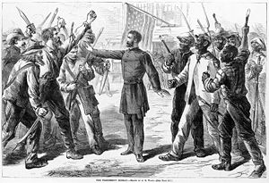
Freedmen’s Bureau
The Freedmen’s Bureau was a government agency that aided free slaves during the Reconstruction. The Bureau’s main goal was providing emergency food, housing, and medical needs to freed slaves, though it also helped to reunite families. Later, it’s main job was setting up work opportunities and supervising labor contracts.

Slide 7
Sharecropping
After the Civil War, during the Reconstruction, many of the freed slaves turned to sharecropping as their source of income. Sharecropping is a system of agriculture, or farming, in which a landowner allows a tenant to use the land in return for a share of the crop produced on the land. Sharecropping contracts generally functioned on the 50%-50% rule; though some landowners would take advantage of the uneducated freed slaves and write 30%-70% contracts.

Slide 8
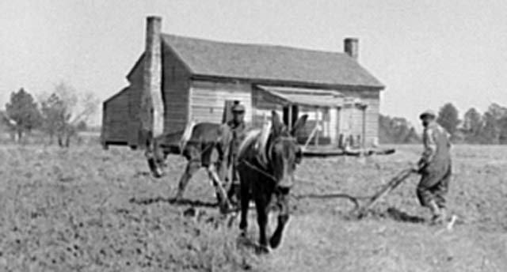

Slide 9
After the Civil War, many African Americans still worked on large cotton plantations. The plantation owners paid African Americans for their work. Free schools were started for them. African American children and adults went to school. They wanted to learn. Many adults went to school at night because they worked all day. Sometimes teachers from the North came to teach the African Americans.

Slide 10
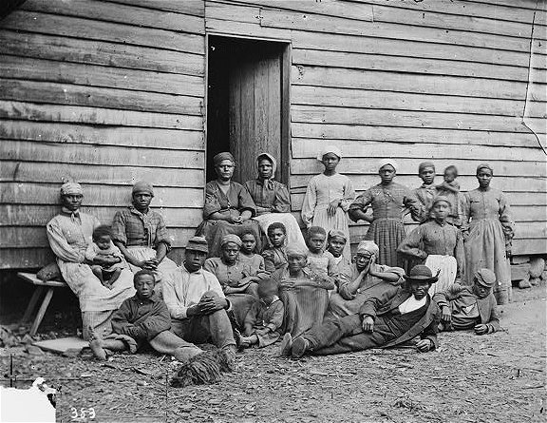

Slide 11
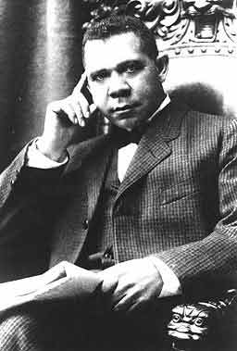
Booker T. Washington
Booker T. Washington was a man who helped other African Americans get better jobs. Booker T. Washington had been a slave, but he became free after the Civil War. Washington went to school. He became a teacher. Booker T. Washington said that African Americans must learn to do many different kinds of jobs. He started a school for African Americans in Alabama. His school was called Tuskegee Institute. People could learn to do many kinds of work at Tuskegee. Then they could get better jobs. Tuskegee became a very large school. Thousands of students have studied at Tuskegee Institute.

Slide 12
Amendments
After the war United States senators and representatives wanted to help African Americans have better lives. So they added three laws, or amendments, to the Constitution. The first law was the Thirteenth Amendment. The Thirteenth Amendment said that no one in the United States could own slaves. Never again would there be slavery in American. The second law to help African Americans was the Fourteenth Amendment. This law said that African Americans were citizens. It also said all people have equal rights. The third law to help African Americans was the Fifteenth Amendment. This law said African American men could vote. At that time American women were not allowed to vote.

Slide 13
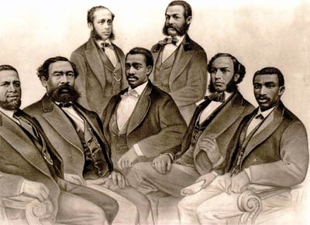
Government
During Reconstruction African Americans voted for the first time. By 1900 more than twenty African Americans had become senators and representatives in Congress. But as time passed, laws were written in the South that were not fair to African Americans. Some laws made it hard for African Americans to vote.

