Slide 1
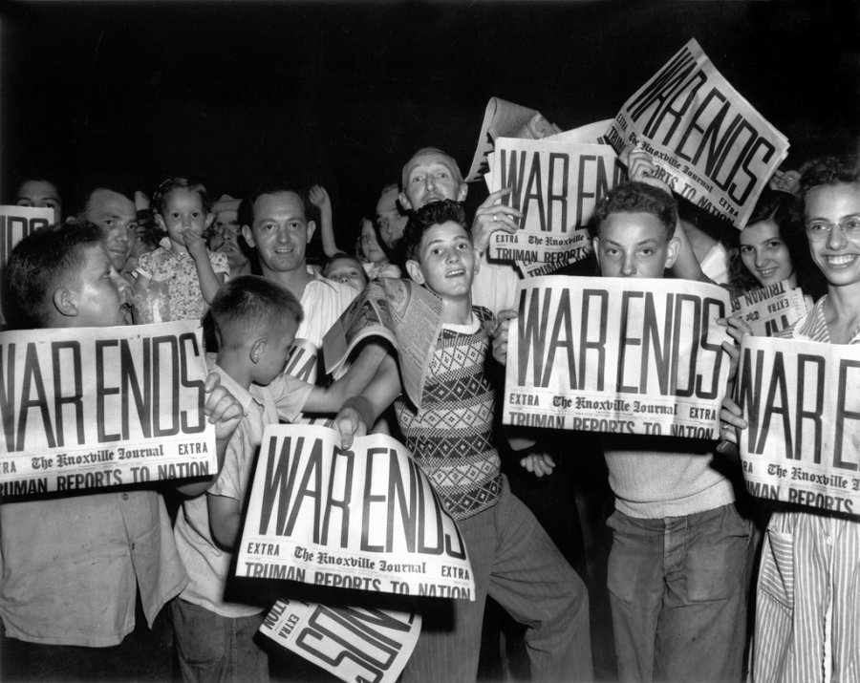
The End of World War II

Slide 2
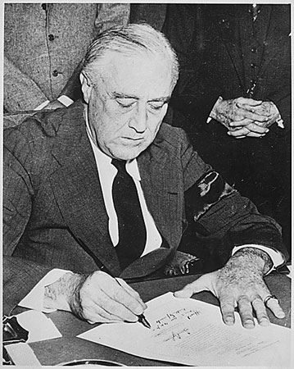
Introduction
The Axis countries were fighting to conquer many countries during World War II. In December 1941 the United States began to fight in the war. Millions of American soldiers would help the Allies win.

Slide 3
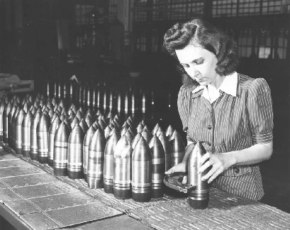
Life in America
Life in America changed in many ways. Millions of people began to work in factories making weapons for the war. Most of the nation’s men were fighting in the war. So many women worked in factories to make ships, airplanes, guns, tanks and clothing that the soldiers needed. Because there were so many new jobs, the war helped end the Great Depression.

Slide 4
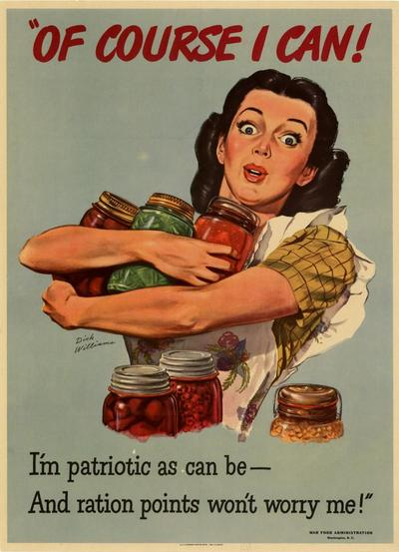
America Helps Out
American farmers worked hard to grow extra crops for food. The United States sent food to the American and Allied soldiers who were fighting in the war. There was not enough food for people at home to have all they wanted. Some foods were rationed. Families could buy only small amounts of some foods, such as meat, sugar, and flour.
The United states needed metal during the war. Metal was used to make weapons. Many people collected old metal. Old metal was used to make ships, guns, tanks, and bullets for the war.

Slide 5
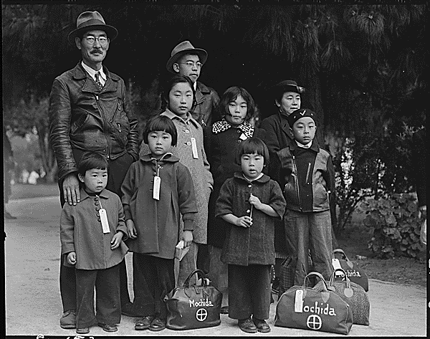
Japanese Americans
The United States government was unfair to Japanese Americans during the war. Japanese Americans had always been good citizens. But after Japan bombed Pearl Harbor, many people were angry with the Japanese Americans. The government forced thousands of Japanese Americans to move to special camps. They had to live in small, ugly houses. Guards watched the people in these camps day and night. But some Japanese American men decided they wanted to help the United States win the war. They fought for America even though they were not treated fairly. They were brave soldiers. They helped America win the war.

Slide 6
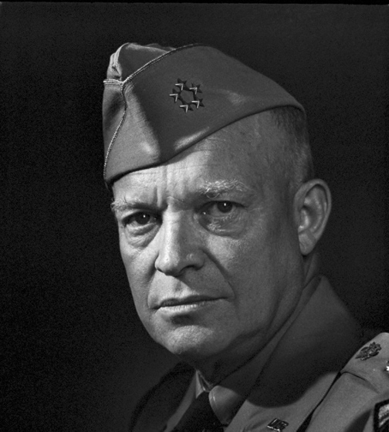
Dwight D. Eisenhower
General Dwight D. Eisenhower led the American army in Europe. In 1944 he became the leader of all the Allied soldiers. Soldiers from Great Britain, France, Canada, the United States, and other countries were fighting for the Allies. General Eisenhower helped all these soldiers work together to fight against the Axis countries.

Slide 7
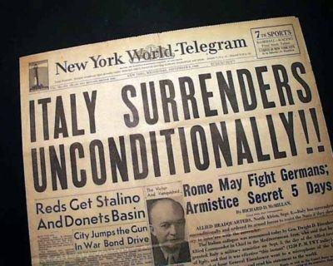
Italy Falls
General Eisenhower led the Allied soldiers to Italy. German soldiers went to Italy to help the Italians fight against the Allies. The Allies fought for many months in Italy. At last, in 1944 the Italians surrendered. Italian soldiers would not fight against the Allies again.

Slide 8
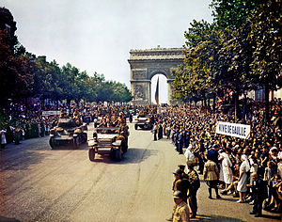
The Allies Free France
Adolf Hitler still rules France and most of Europe. The Allies wanted France to be free again. In June 1944 General Eisenhower invaded France with thousands of Allied soldiers. The Allies fought the Germans in France. After two months the Allies captured Paris. France soon became a free nation again.

Slide 9
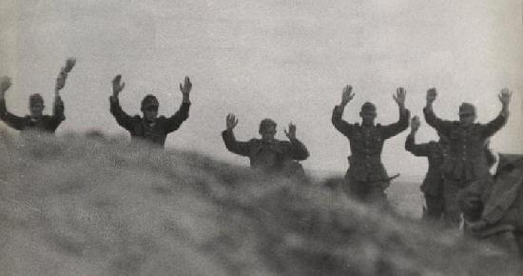
Germany Surrenders
The Germans were losing the war. But Adolf Hitler would not surrender. The Allies attacked Germany. American planes dropped bombs on German cities. Much of Germany was destroyed. Finally, on May7, 1945, the Germans surrendered to the Allies. Europe had peace again.

Slide 10
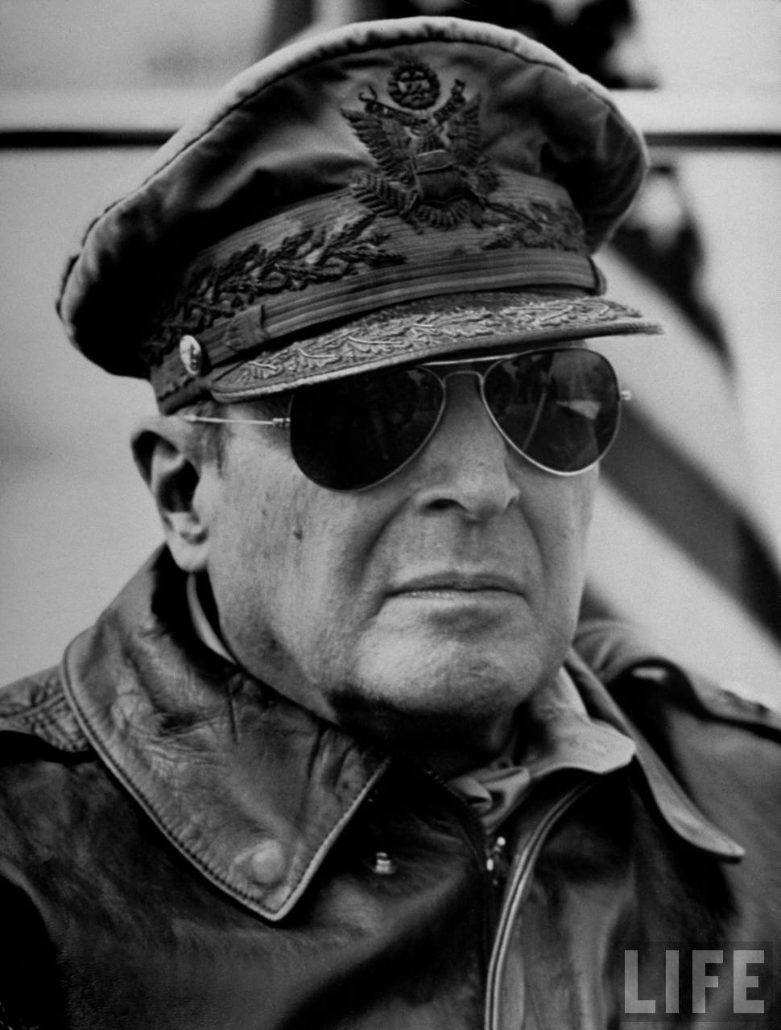
The War in Asia
Thousands of Americans were fighting in Asia at the same time General Eisenhower and his soldiers were fighting in Europe. General Douglas MacArthur led the American soldiers in Asia. Japan had captured the Philippines, Guam, and other islands in the Pacific Ocean. General MacArthur said that he would help Guam and the Philippines become free again.

Slide 11
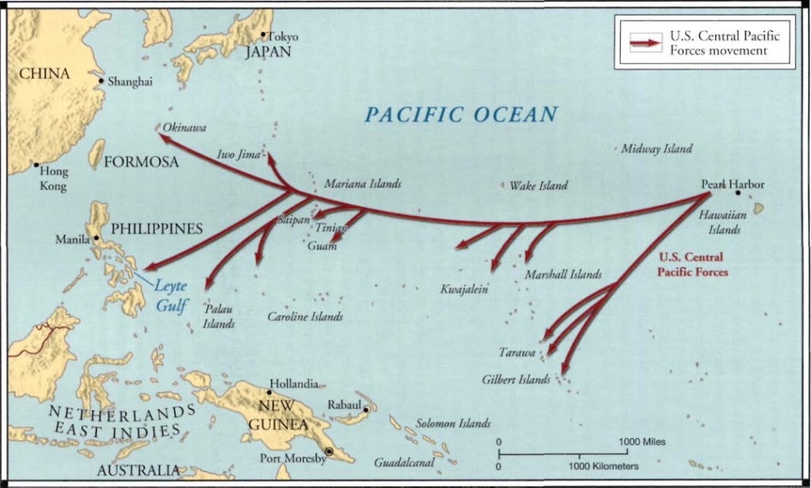
Island Hopping
General MacArthur and the American soldiers fought the Japanese on many islands in the Pacific Ocean. Slowly the Americans captured many islands from Japan. American Guam and the Philippines became free. Then the United States attacked Japan. The Japanese were losing the war. But they would not surrender.

Slide 12
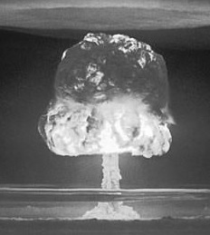
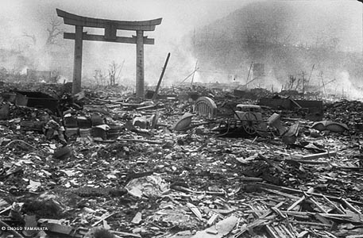
The Atomic Bomb
The United States had a powerful new weapon. It was called the atomic bomb. Harry S. Truman was now the President of the United States. He wanted the war to end quickly. Every day more Americans were killed during the war. Japan would not stop fighting. President Truman decided to force Japan to surrender. He decided that an American plane would drop an atomic bomb on a Japanese city.

Slide 13
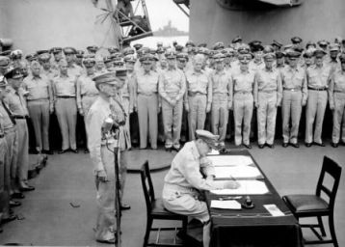
Japan Surrenders
On August 6, 1945, the United States dropped the first atomic bomb. It destroyed most of the city of Hiroshima. Japan would not surrender. A few days later, Americans dropped an atomic bomb on the city of Nagasaki. These powerful bombs killed thousands of Japanese. On August 14, 1945, Japanese leaders surrendered to the Allies. There was peace in Asia. World War II was over. Americans were glad that a terrible war had ended.

Slide 14
