Slide 1
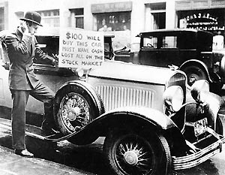
The Great Depression

Slide 2
Introduction
The year was 1930. Most Americans had little money. Many people did not have money to buy bread, even though a loaf of bread cost only five cents. Americans were living through the years of the Great Depression.
The Great Depression was not the nation’s first depression. But it was the longest and hardest depression. It lasted more than ten years. It started in the United States. Then the depression spread to Europe and other countries. During those years millions of Americans lost their jobs. Many people did not have enough money to pay for food, clothes, or homes.

Slide 3
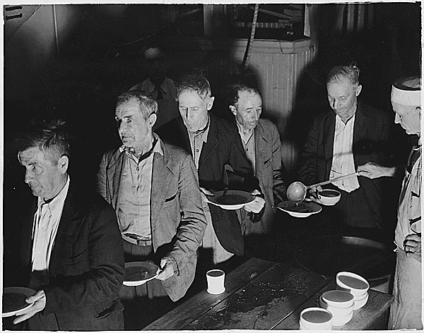
Soup Kitchens during the Great Depression

Slide 4
Causes of the Great Depression
Stock Market Crash
Farmers
Factories
Low Salaries

Slide 5
Causes: The Stock Market Crash
The Great Depression began in 1929. At that time many Americans had been buying shares of stocks. Buying a share of stock means owning a small part of a business. When the business makes money, your stock makes money. Then you can sell your stock and get back more money than you paid for it. Sometimes the businesses don’t do well. Then the owners of the stock sell the stock for less money than they paid for it.
Americans bought stock in many businesses. They bought and sold stock on the stock market. Many Americans did not have enough money to buy the stock they wanted. So they borrowed money from banks to buy stocks. The banks bought stocks, too.

Slide 6
Causes: The Stock Market Crash
On October 29, 1929, the stock market crashed. The price of most stocks on the stock market became very, very low. On that day almost everyone wanted to sell their shares of stock. No one wanted to buy shares. Shares were sold for much less money than people had paid for them. People lost millions of dollars. They couldn’t pay back the money they had borrowed from the banks. So banks could not get the money people had borrowed to buy stocks. Banks lost more money because they had bought stocks, too. The money that banks lost was money that people had saved in the bank. Suddenly, many people became very poor when the stock market crashed.

Slide 7
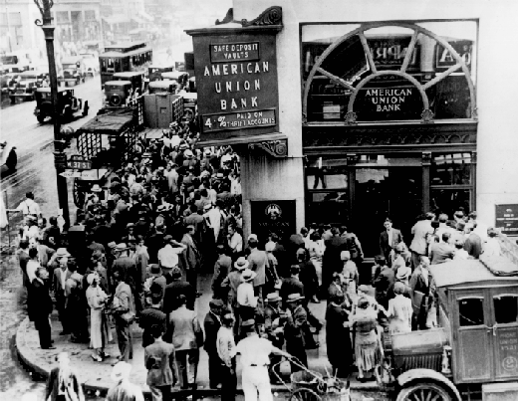
Run on the Banks

Slide 8
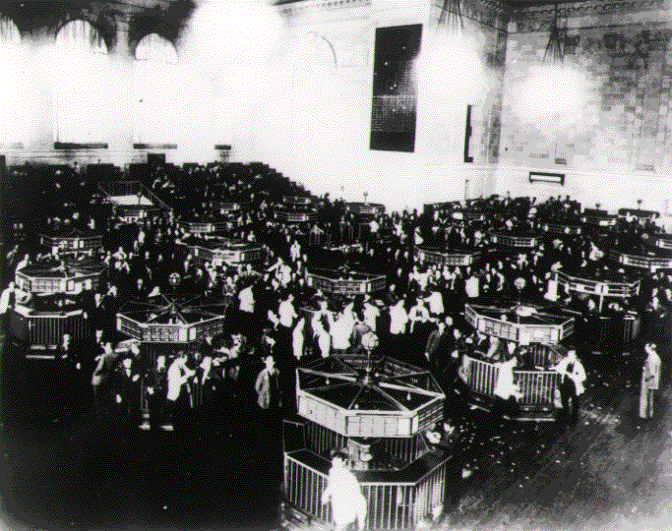
Stock Market Crash

Slide 9
Causes: Farmers
Three other problems helped cause the Great Depression. The first problem was that farmers grew more crops than they could sell after World War I. Then the farmers had to sell their crops at very low prices. They sold the crops for less than they had spent to plant the crops. So many farmers did not earn enough to pay for their farms.

Slide 10
Causes: Factories
The second problem was that factories were making too many products. Americans could not buy all the things that were being made. Factory owners sold their products for less and less money. Many factories were forced to closed. Many workers lost their jobs.

Slide 11
Causes: Low Salaries
Low salaries were the third problem. Workers were not earning enough money. They could not buy the farm crops and factory products. Everything became cheaper and cheaper. Soon almost everyone was losing lots of money.

Slide 12
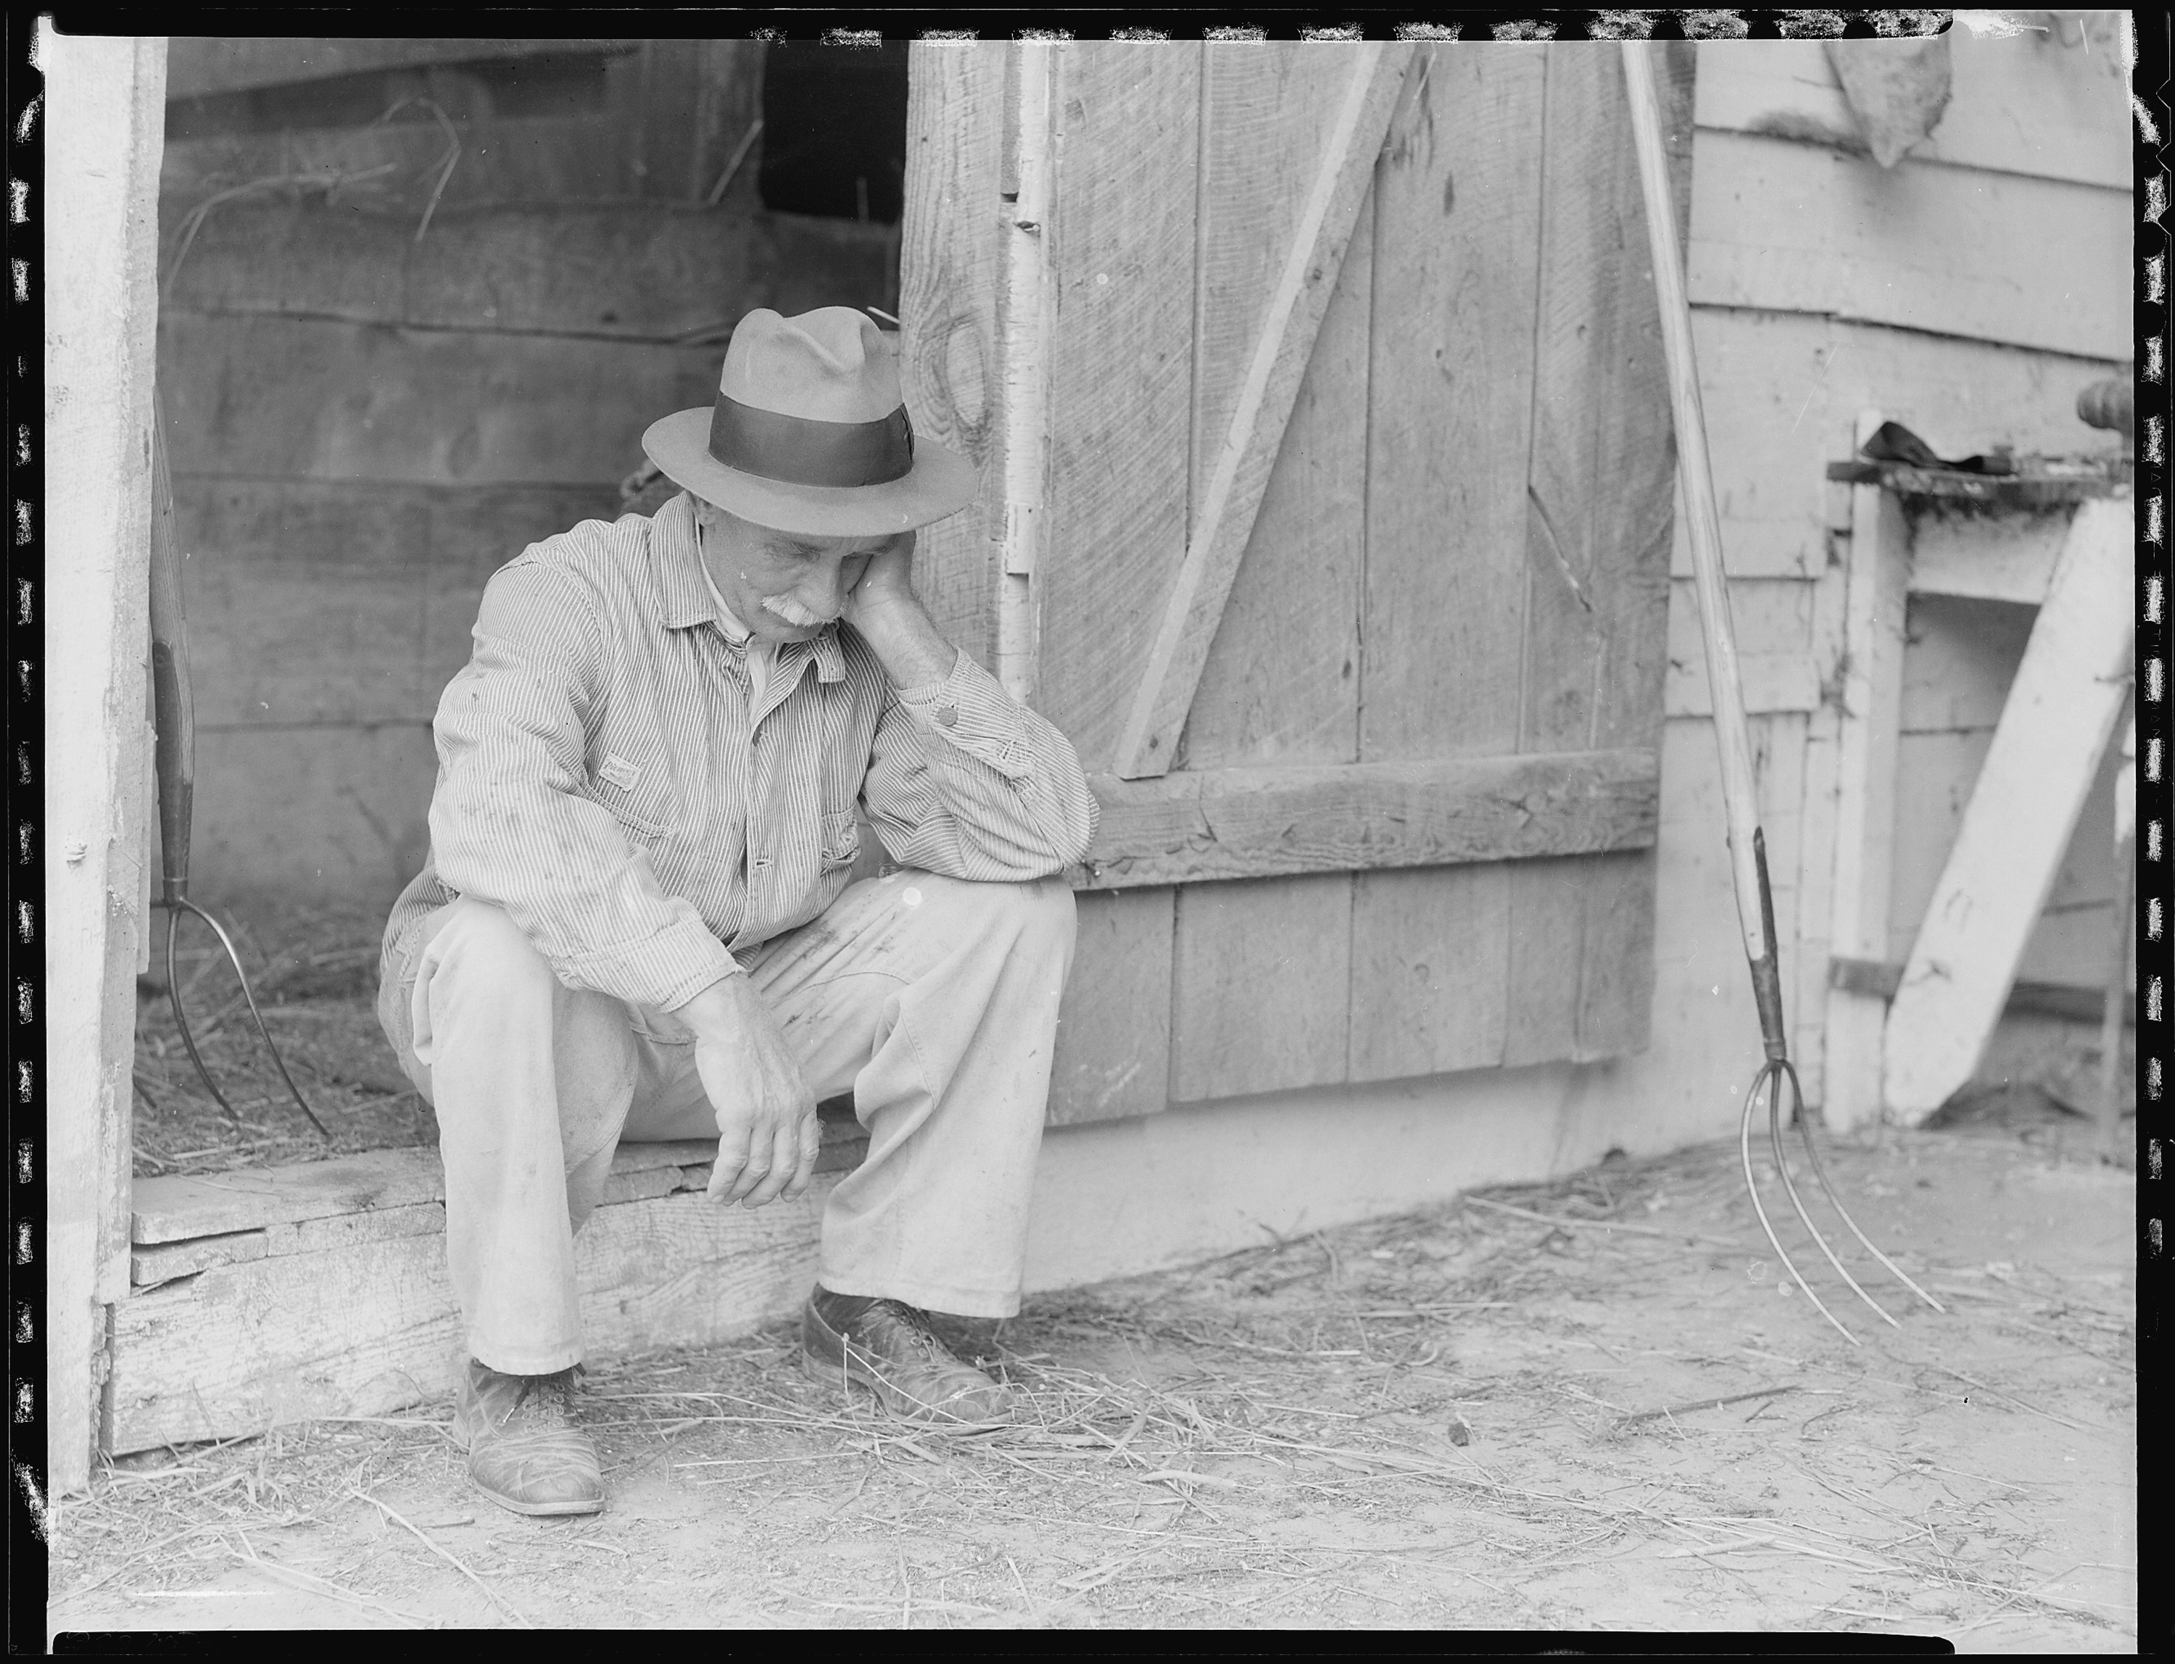
Great Depression Farmer

Slide 13
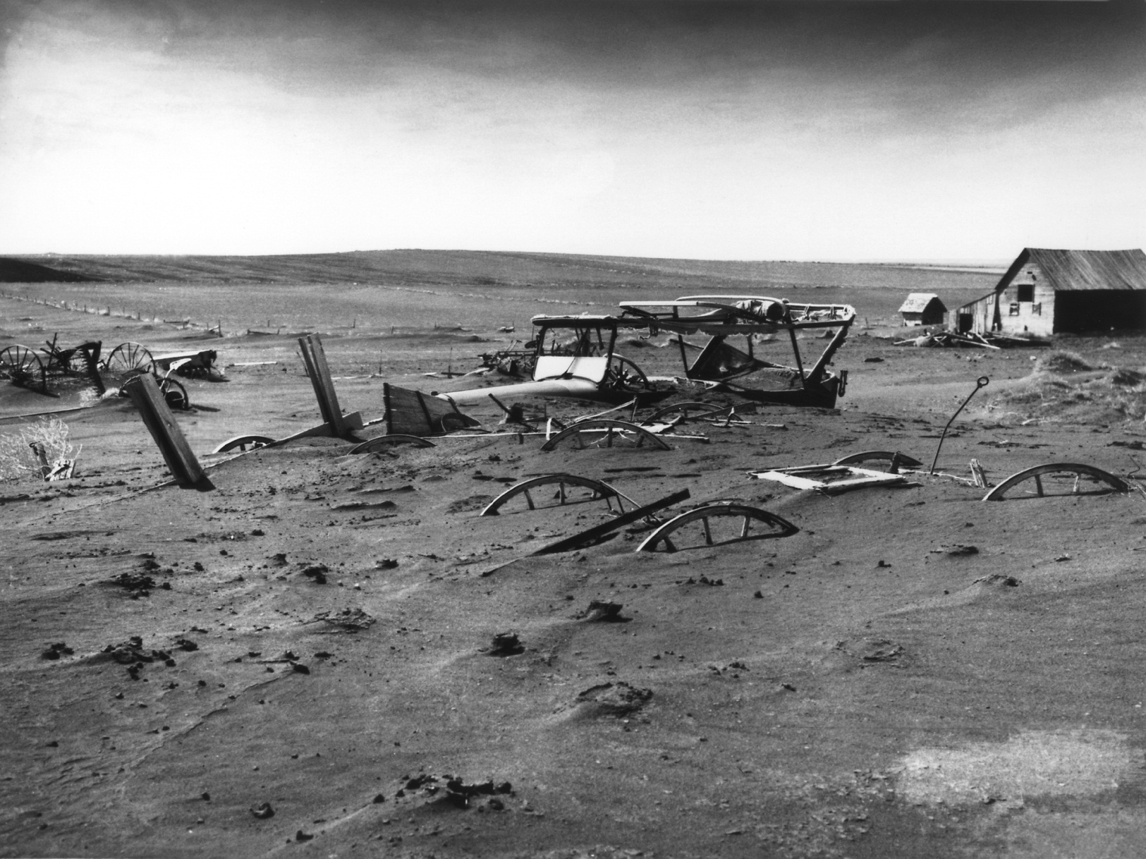
Great Depression Farm

Slide 14
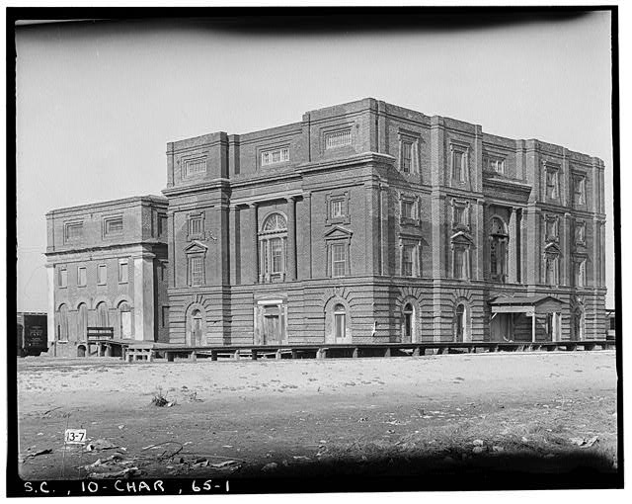
Great Depression Factory

Slide 15
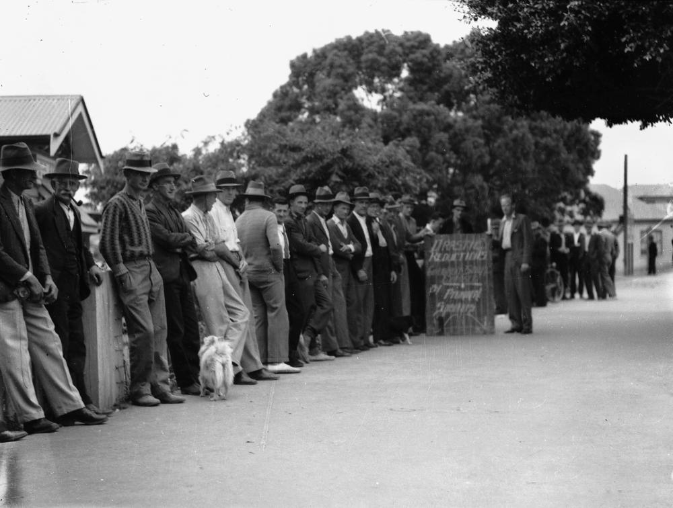
Unemployment during the Great Depression

Slide 16
A New Deal
Franklin D. Roosevelt
Laws to help Farmers
Cleaning up the Banks
WWII

Slide 17
Introduction
Herbert Hoover was President of the United States when then depression started. He thought the depression would end quickly. The depression grew worse each year. Hoover was not popular. Americans felt he did not do enough to end the depression. In 1932 Americans elected a new President.
Franklin D. Roosevelt became President in 1933. Roosevelt promised a “New Deal” for America. He promised to try to end the depression.

Slide 18
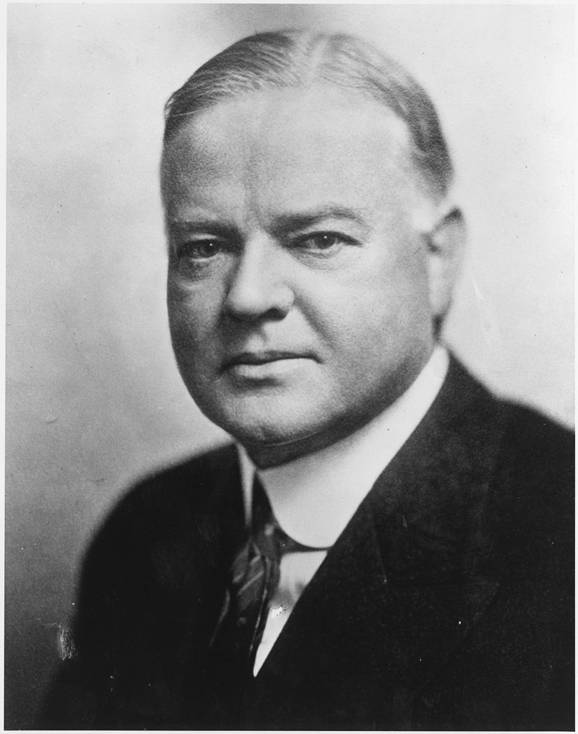
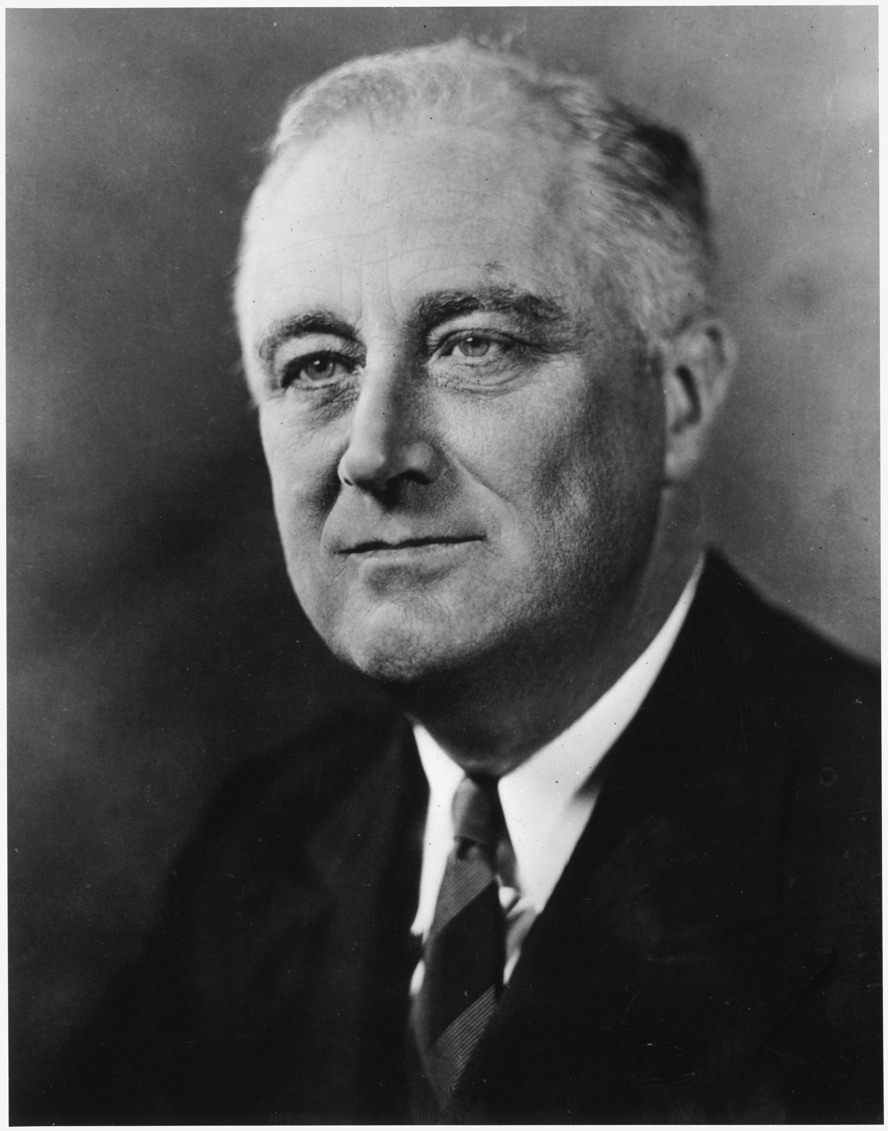
From Hoover to Roosevelt

Slide 19
New Deal: Putting America Back to Work
Roosevelt and the New Deal helped America. When Roosevelt became President, 13 million workers had lost their jobs. Roosevelt wrote laws with Congress to make new jobs for Americans. The government paid people to build roads, bridges, and parks. Americans also built new schools and buildings, both through the Public Works Administration (PWA). Millions of trees were planted across the nation.

Slide 20
New Deal Helps Farmers
Roosevelt also helped the farmers. New laws helped the farmers borrow money to pay for their farms. Farmers were paid to grow less food. Food prices grew higher because their was less food to buy. Slowly many farmers began to earn more money.

Slide 21
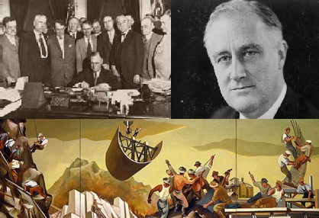
New Deal

Slide 22
New Deal: Cleaning up the Banks
President Roosevelt knew the United States needed strong, safe banks. Roosevelt forced all the banks to close for a bank holiday. After a few days, only safe banks were allowed to open. Americans began to put money in banks again.

Slide 23
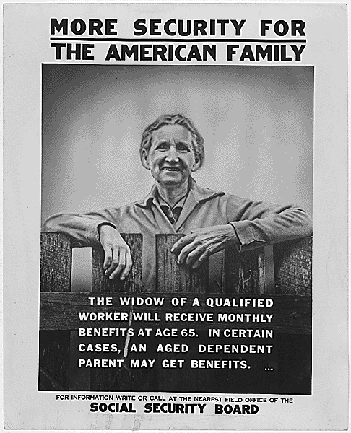
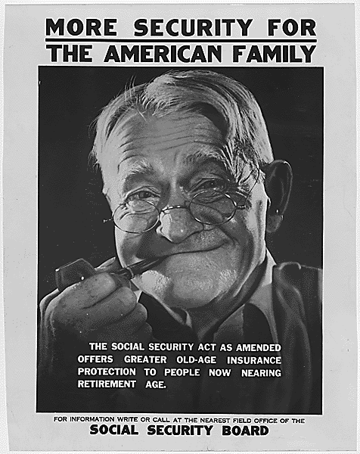
Other New Deal Programs
Social Security

Slide 24
The Great Depression Ends
Franklin D Roosevelt was a very popular President. He was the only President to be elected four times. He was President for twelve years. Most Americans felt Roosevelt worked hard to end the depression.
The depression ended when World War II began. Then their were new jobs because of the war. Men became soldiers. Men and women worked in factories making guns, warships, tanks, and other things for war. The depression slowly ended. Americans would never forget the hard, hungry years of the Great Depression.

Slide 25
