Slide 1
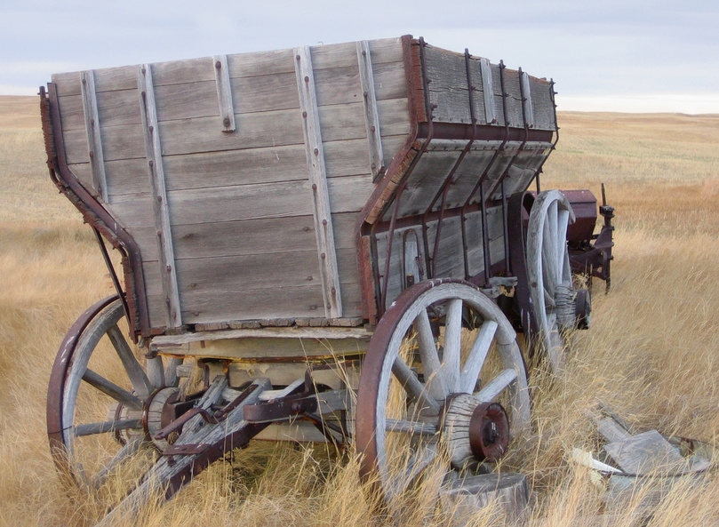
Westward Expansion
The Life of a Pioneer

Slide 2
Essential Questions
How did the Homestead Act help Americans settle in the West?
How did railroads help Americans move west?
Vocabulary: Homestead Act, reservations, immigrants

Slide 3
The Great Plains
The land between the Mississippi River and the Rocky Mountains is called the Great Plains. In the 1840s and 1850s, many Americans traveled west across the Great Plains and the Rocky Mountains to California and Oregon. Not many Americans wanted to live on the Great Plains. There was very little rain. The land was flat, and there were few trees. Americans did not think they could grow food on the Great Plains.

Slide 4
The Homestead Act
In 1862 the United States senators and representatives in Congress wrote a new law. It was called the Homestead Act. The Homestead Act gave land to settlers on the Great Plains for a very low price. The Homestead Act said settlers must live on the land they had paid for. The settlers had to build a house and a farm on the land.

Slide 5
The Farms of the Great Plains
Thousands of poor Americans moved to the Great Plains because of the Homestead Act. After the Civil War, African Americans also moved west to get land at a low price. Many farms were started on the Great Plains. Some farmers grew corn. Other farmers grew wheat. Breads and cakes were made from the wheat once it became flour.

Slide 6
Pioneer Life
It was hard work to be a wheat farmer on the Great Plains. Sometimes there was not enough rain for the wheat to grow. Many times there were bad windstorms. There were terrible snowstorms in the winter. People lived far apart on the Great Plains. Many people were lonely. The farmers worked hard. They learned better ways to grow wheat. Today most of our wheat comes from the Great Plains.

Slide 7
Buffalo
As Americans moved west, they settles on land where Native Americans lived. These Native Americans had always been buffalo hunters. Millions of buffalo lived on the Great Plains. The buffalo moved from place to place. The Native Americans moved from place to place as they hunted buffalo.
Native Americans used every part of the buffalo they killed. They ate the meat. They made clothes and tents from the animal skins. They made tools and weapons from the horns and bones.

Slide 8
Native Americans
Native Americans were not happy when settlers built farms on the Great Plains. The settlers wanted Native Americans to live in one place. They did not want Native Americans to travel all over the Great Plains hunting for buffalo. There were many battles between the Native Americans and the settlers. Many settlers were killed. But many more Native Americans were killed.

Slide 9
Reservations
The United States government told the Native Americans to stop moving from place to place. The government gave the Native Americans land to live on. These lands are called reservations. Many Native Americans became farmers on the reservations. They were not happy. Their land was not good for farming. They did not want to be farmers. They wanted to be buffalo hunters. They could not hunt buffalo on the reservations.

Slide 10
Railroads
As Americans moved west, they needed better ways to travel. At first, people traveled with horses and covered wagons. Railroads would take Americans to the West faster. There were many railroads in the East, but there were no railroads across the West.

Slide 11
Railroad
After the Civil War, Americans started building railroad tracks across the West. Thousands of people helped build the railroads. African Americans and Mexican Americans worked on the railroads. Immigrants from Ireland also helped. Thousands of Chinese immigrants came to work on the railroads. They built railroads through the tall Rocky Mountains. The work was hard and dangerous.

Slide 12
Railroads
In 1869 the first railroad tracks across the United States were finished. This was called the Transcontinental Railroad. The Union Pacific Railroad was started in the East. The Central Pacific Railroad was started in the West. The two railroad tracks were connected together in Utah. A spike made of gold connected them. Now people could travel by train from the eastern states to California.

Slide 13
Railroads
Americans continued to build more railroads. The Northern Pacific Railroad was built across the northern states. The Southern Pacific Railroad was built across the southern states. Every year more and more Americans traveled west in trains.

Slide 14
Wrap-Up
Many of our states today are part of the Great Plains and the West. The Homestead Act and the railroads helped thousands of people build the American West.

