Slide 1
World War I

Slide 2
The Beginning
In 1914 war started in Europe
Countries in Europe started building armies and wanted to have the strongest army with the more soldiers
Imperialism became an important part of WWI- countries like Germany and Great Britain wanted to win control over other countries

Slide 3
Countries
There were two groups of countries in Europe:
Allies
Central Powers
Countries who did not want to help the Allies or the Central Powers were neutral
The Allies- promised to help each other during the war
Great Britain
France
Russia
Serbia
The Central Powers- promised to help each other during the war
- Germany
- Austria-Hungary

Slide 4
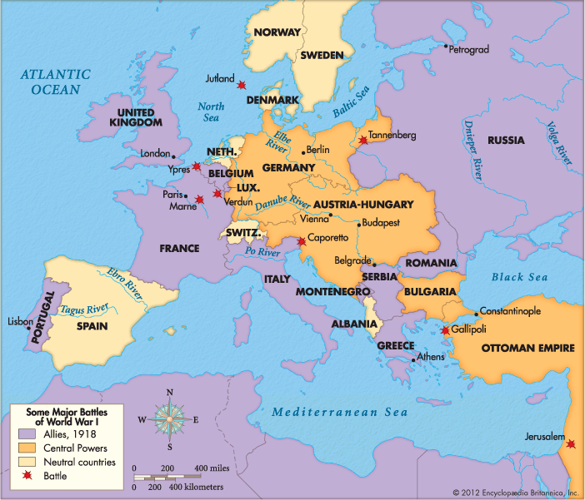
Map of the Powers

Slide 5
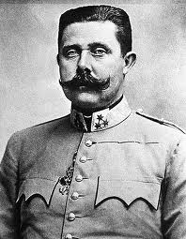
The Prince
One day in 1914, the prince of Austria-Hungary was shot and killed by someone from Serbia. The people from Austria- Hungary were angry and Serbia was one of the allies and kept their promise to help them fight. While Austria-Hungary was a central power and the Central Powers kept their promise and WWI started!!!
Who was the Prince???
- Think to all of your presentations of who the Prince was?

Slide 6
The United States
The United Stated did not want to fight in WWI, but were friends with Great Britain and France
The U.S. would send food and weapons to the allies
Germany did not want the U.S. to help the Allies so they in 1917 German ships attacked American ships
Many American ships were sunk

Slide 7
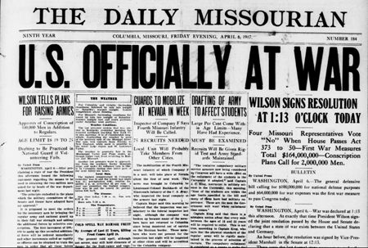
The United States
President Woodrow Wilson decided it was time to fight- after American ships were sunk
Congress voted to fight against Germany and to help the Allies (Great Britain and France)
In 1917 the U.S. started to fight in WWI

Slide 8
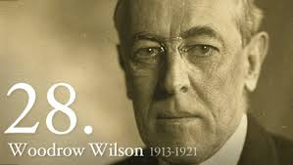
President Woodrow Wilson

Slide 9
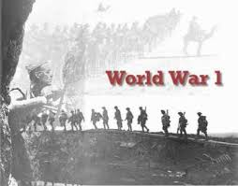
During the war, Americans began to dislike Germans who lived in America- German Americans
They did not like their language or the people of Germany
Many Americans were unfair to German Americans during WWI
- They lost their jobs and stopped teaching the German language

Slide 10
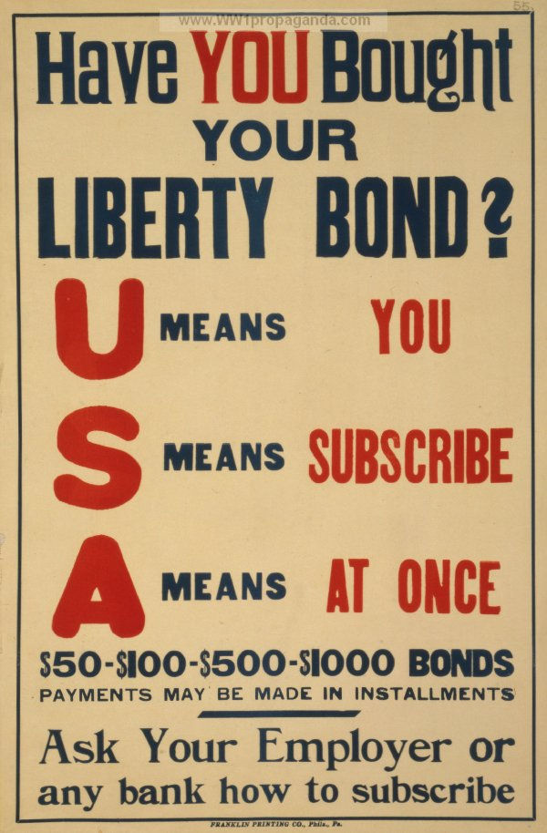
Liberty Bonds
Many Americans bought liberty bonds to help pay for the war. The government did not have enough money to pay for the way, and all the Americans wanted to help during the war.
Americans knew that the Allies needed more food- so they ate less wheat, meat, and sugar.

Slide 11
Surrender
Americans helped the Allies win the war. They tried to capture Paris. Americans helped the Allies save Paris from the Germans
Allies and the Americans fought against the German army until finally the German army became weaker and weaker.
Germany and the Central Powers surrendered and the WWI ended on November 11, 1918.
The Allies had won and the Americans were glad there was peace in the World for now.
President Woodrow Wilson wanted Peace and went to France to help write a Peace treaty- Treaty of Versailles

Slide 12
