Slide 1
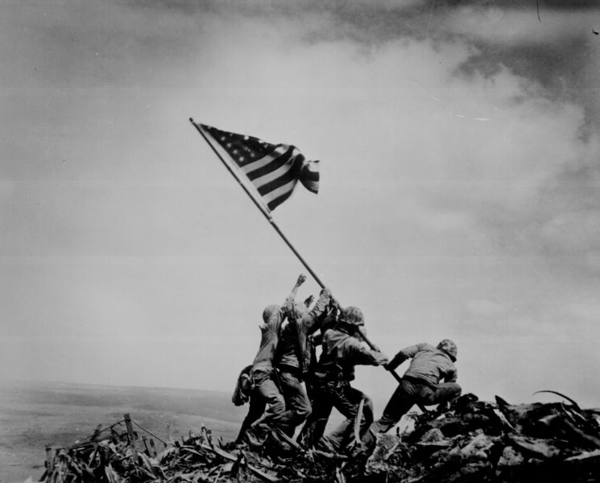
World War II Begins

Slide 2
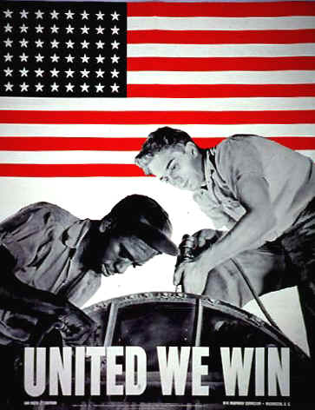
Introduction
World War I ended in 1918. Twenty-one years later, in 1939, World War II began. What caused the war to begin? What did Americans do during World War II?

Slide 3
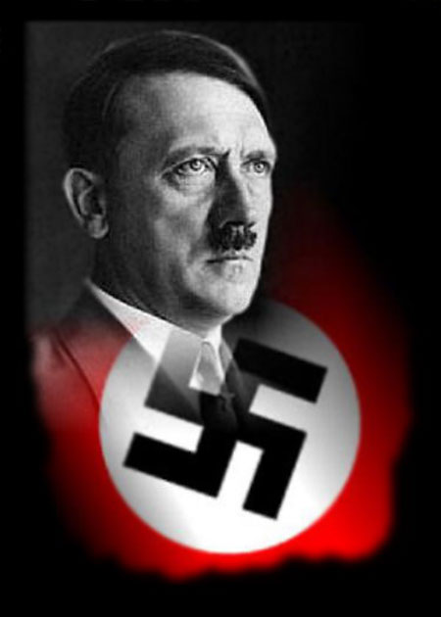
The Rise of Adolf Hitler
Great Britain and France punished Germany after World War I. Great Britain and France made Germany pay large amounts of money to them after the war. The Great Depression brought hard years to Germany and other countries in Europe. The German people were unhappy. They wanted a new leader to help them. In 1933 Adolf Hitler became the leader of Germany.

Slide 4
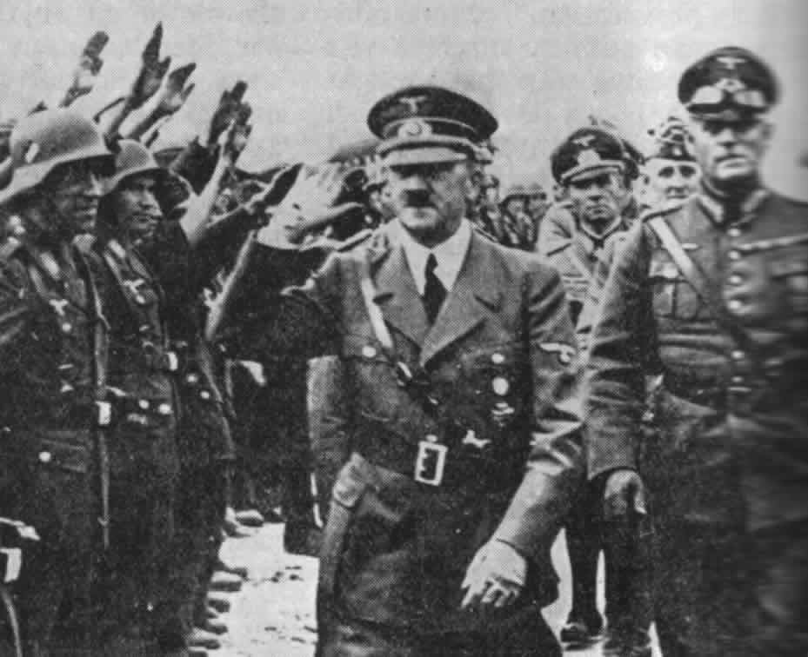
A March Towards War
Adolf Hitler was a dictator. He had full power to rule Germany. People who spoke against Hitler were killed. Hitler said many things that the German people liked. He said he would help Germany become a strong county again. He told the Germans to fight in another war. He said that Germany would conquer and rule much of Europe. Many German people liked what Hitler said. They wanted Germany to be strong and powerful again. The Germans got ready for another war. They built airplanes, bombs, and ships.

Slide 5
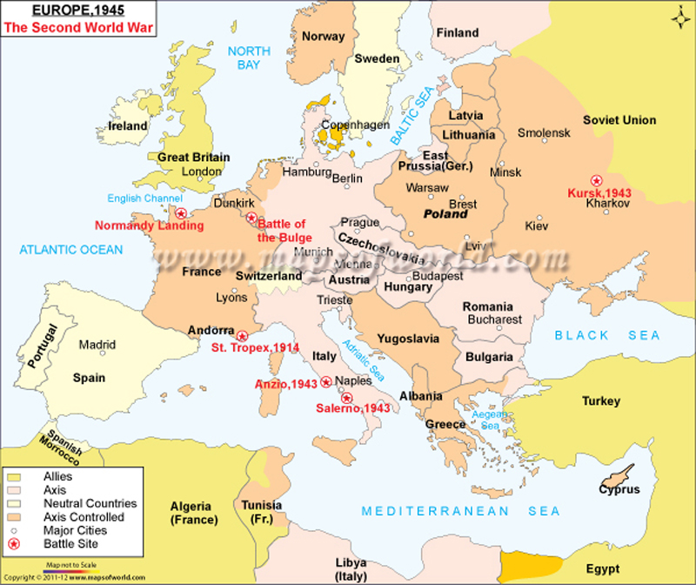
Taking Sides
Italy and Japan also wanted to conquer and rule other countries. Germany, Italy, and Japan were called the Axis countries. They promised to help each other during a war. Great Britain, France, and some smaller countries were called the Allies. Some countries were neutral countries. They did not fight for the Axis countries or for the Allies.

Slide 6
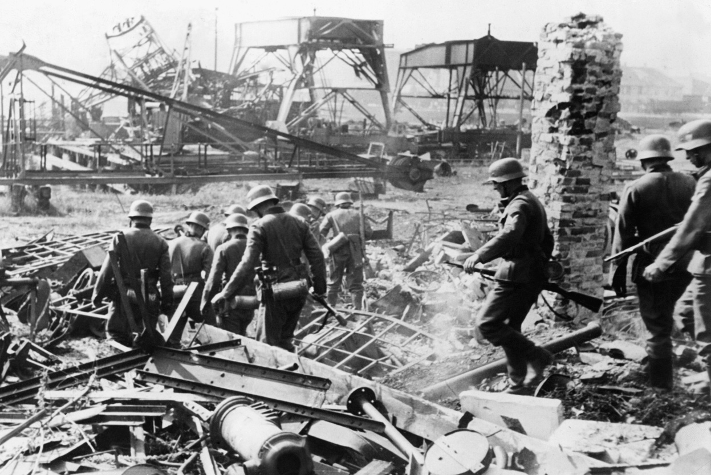
A Victory for the Axis Countries
World War II began in September 1939. Germany attacked Poland. The armies of the Allies were not ready for war. But they sent their soldiers to help Poland. The German army was very strong. In a few weeks, Germany captured Poland. German soldiers captured more countries in Europe.

Slide 7
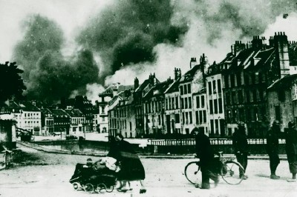
Germany Takes Control of France
Great Britain and France tried to stop the German army. Their armies were not strong enough. Then Germany attacked France. The Germans quickly captured the city of Paris. Thousands of British and French soldiers escaped from France in small boats. They went to Great Britain. These soldiers would continue to fight against Hitler. In 1940 Germany ruled all of France.

Slide 8
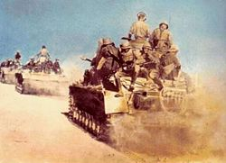
1940-1941
The years of 1940 and 1941 were very bad years for the Allies. Italy was trying to capture northern Africa. Japan was attacking countries in Asia. Germany had conquered many countries in Europe.

Slide 9
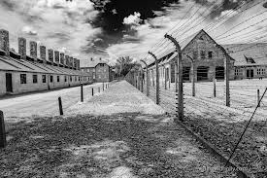
The Holocaust
Hitler brought fear to all of Europe. People who said they did not like Hitler’s government were killed in death camps. These death camps were called concentration camps. Hitler did not like Jewish people, or Jews. His goal was to kill all the Jewish people in Europe. German soldiers forced Jews in most conquered countries to leave their homes.

Slide 10
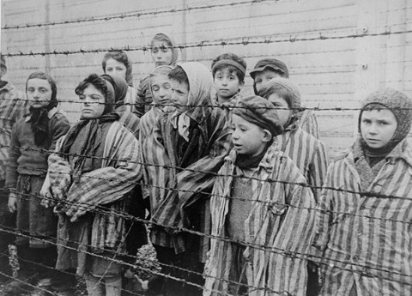
The Holocaust
They forced millions of Jews to go on special trains to concentration camps. Many Jews wanted to escape. But few governments would allow Jews to come and live in their countries. So about six million Jewish people were killed in concentration camps. This killing of millions of Jews and other people is now called the Holocaust. Never before had so many people been killed because of one leader.

Slide 11
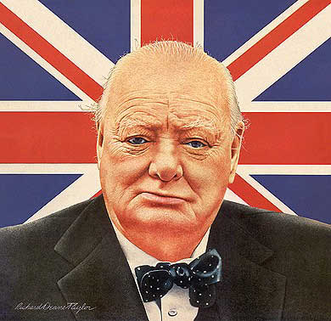
Winston Churchill
Great Britain was the only country in Europe that could fight against Hitler. The British had an excellent leader. His name was Winston Churchill. He believed that people in many nations would lose their freedom if Hitler won the war. Churchill said that Great Britain would never surrender to Hitler. In 1940 Germany tried to capture Great Britain. German planes dropped thousands of bombs on British cities. The brave British pilots shot down hundreds of German planes. Great Britain remained free.

Slide 12
The U.S. Helps Out
Franklin D Roosevelt was the President of the United States. He knew that Great Britain needed help to fight against Germany. He told Americans to help the British people. American factories made guns, planes, bombs, tanks, and ships. The United States also gave loans to Great Britain. The United States sent food, weapons, and money to Great Britain.

Slide 13
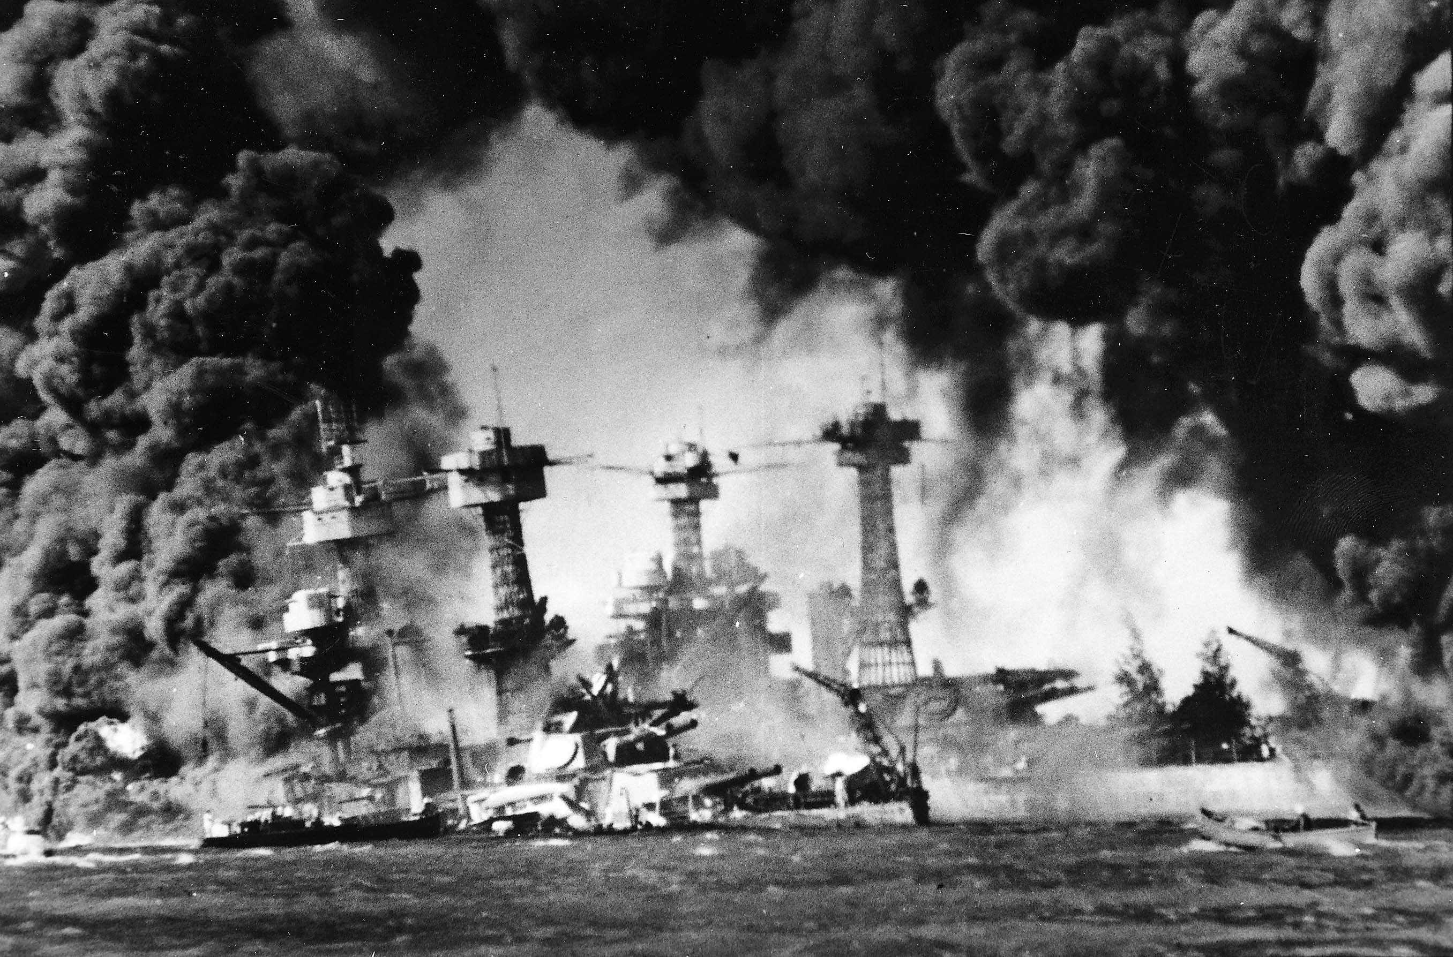
The United States Enters the War
Suddenly the United States had to fight. On December 7, 1941, the Japanese attacked Pearl Harbor. Pearl Harbor was an American naval base in Hawaii. The Japanese killed more than 2,000 American soldiers. They destroyed many American ships and airplanes. Americans were very angry. The next day, the United States declared war on Japan. A few days later, Italy and Germany said they were at war with the United States. The United States was now at war with all the Axis countries.

